Slide 1
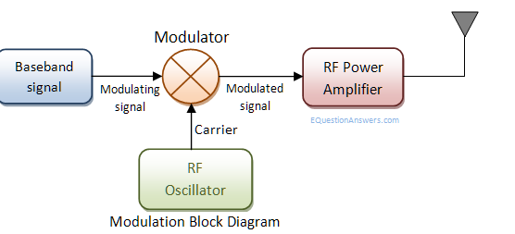
Modulation
Modulation is the process of varying one or more parameters of a carrier signal in accordance with the instantaneous values of the message signal. The message signal is the signal which is being transmitted for communication and the carrier signal is a high frequency signal which has no data, but is used for long distance transmission.

Slide 2
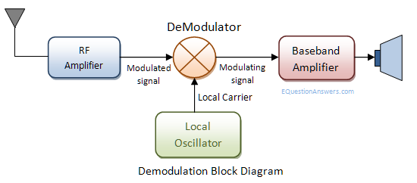
Demodulation
Demodulation is the opposite process of modulation where the varying amplitude, frequency or phase of carrier signal is extracted to construct the original the message signal.

Slide 3
Pulse Code Modulation (PCM).
A signal is pulse code modulated to convert its analog information into a binary sequence, i.e., 1s and 0s. The output of a PCM will resemble a binary sequence. The following figure shows an example of PCM output with respect to instantaneous values of a given sine wave.

Slide 4
Basic Elements of PCM
The basic operations in the receiver section are regeneration of impaired signals, decoding, and reconstruction of the quantized pulse train. Following is the block diagram of PCM which represents the basic elements of both the transmitter and the receiver sections.

Slide 5
Low Pass Filter
This filter eliminates the high frequency components present in the input analog signal which is greater than the highest frequency of the message signal, to avoid aliasing of the message signal.
Sampler
This is the technique which helps to collect the sample data at instantaneous values of message signal, so as to reconstruct the original signal. The sampling rate must be greater than twice the highest frequency component W of the message signal, in accordance with the sampling theorem.
Quantizer
Quantizing is a process of reducing the excessive bits and confining the data. The sampled output when given to Quantizer, reduces the redundant bits and compresses the value.

Slide 6
Encoder
The digitization of analog signal is done by the encoder. It designates each quantized level by a binary code. The sampling done here is the sample-and-hold process. These three sections (LPF, Sampler, and Quantizer) will act as an analog to digital converter. Encoding minimizes the bandwidth used.
Regenerative Repeater
This section increases the signal strength. The output of the channel also has one regenerative repeater circuit, to compensate the signal loss and reconstruct the signal, and also to increase its strength.
Decoder
The decoder circuit decodes the pulse coded waveform to reproduce the original signal. This circuit acts as the demodulator.
Reconstruction Filter
After the digital-to-analog conversion is done by the regenerative circuit and the decoder, a low-pass filter is employed, called as the reconstruction filter to get back the original signal.

Slide 7
Digital Modulation
Digital Modulation provides more information capacity, high data security, quicker system availability with great quality communication. Hence, digital modulation techniques have a greater demand, for their capacity to convey larger amounts of data than analog modulation techniques.

Slide 8
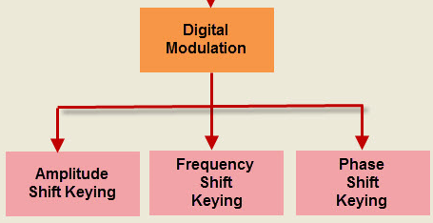
Digital Modulation Techniques

Slide 9
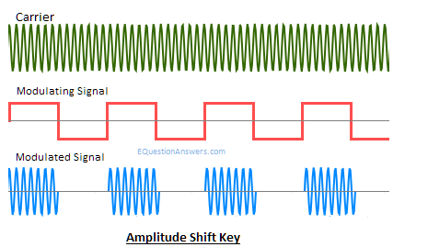
ASK – Amplitude Shift Keying
When the carrier signal's instantaneous amplitude is varied in proportion to message signal m(t). We have the modulated carrier m(t)cos(wc*t) where cos(wc*t) is the carrier signal. As the information is an on-off signal the output is also an on-off signal where the carrier is present when information is 1 and carrier is absent when information is 0. Thus this modulation scheme is known as on-off keying (OOK) or amplitude shift key.

Slide 10
Application:
Used in our infrared remote controls.
Used in fiber optical transmitter and receiver.

Slide 11
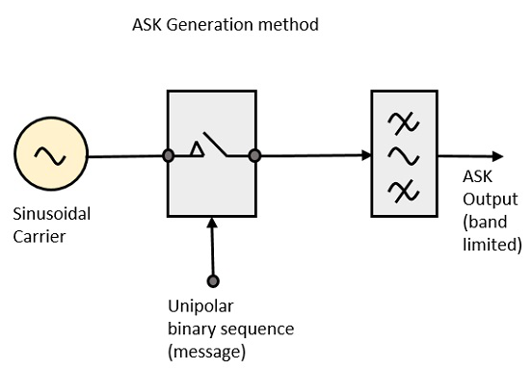
ASK Modulator
The ASK modulator block diagram comprises of the carrier signal generator, the binary sequence from the message signal and the band-limited filter. Following is the block diagram of the ASK Modulator.

Slide 12
ASK Modulator
The carrier generator, sends a continuous high-frequency carrier. The binary sequence from the message signal makes the unipolar input to be either High or Low. The high signal closes the switch, allowing a carrier wave. Hence, the output will be the carrier signal at high input. When there is low input, the switch opens, allowing no voltage to appear. Hence, the output will be low.
The band-limiting filter, shapes the pulse depending upon the amplitude and phase characteristics of the band-limiting filter or the pulse-shaping filter.

Slide 13
ASK Demodulator
There are two types of ASK Demodulation techniques. They are −
Asynchronous ASK Demodulation/detection
Synchronous ASK Demodulation/detection
The clock frequency at the transmitter when matches with the clock frequency at the receiver, it is known as a Synchronous method, as the frequency gets synchronized. Otherwise, it is known as Asynchronous.

Slide 14
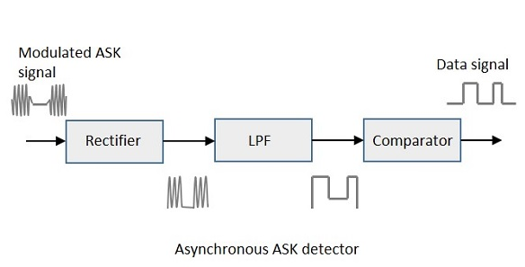
Asynchronous ASK Demodulator
The Asynchronous ASK detector consists of a half-wave rectifier, a low pass filter, and a comparator. Following is the block diagram for the same.

Slide 15
Asynchronous ASK Demodulator
The modulated ASK signal is given to the half-wave rectifier, which delivers a positive half output. The low pass filter suppresses the higher frequencies and gives an envelope detected output from which the comparator delivers a digital output.

Slide 16
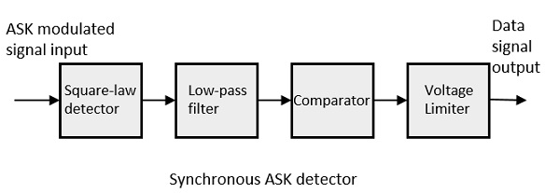
Synchronous ASK Demodulator
Synchronous ASK detector consists of a Square law detector, low pass filter, a comparator, and a voltage limiter. Following is the block diagram for the same.
The ASK modulated input signal is given to the Square law detector. A square law detector is one whose output voltage is proportional to the square of the amplitude modulated input voltage. The low pass filter minimizes the higher frequencies. The comparator and the voltage limiter help to get a clean digital output.

Slide 17
How are binary values represented in amplitude shift keying, and what is the limitation of this approach?
Answer: Amplitude Shift Keying (ASK) is a type of Amplitude Modulation which represents the binary data in the form of variations in the amplitude of a signal. Any modulated signal has a high frequency carrier. The binary signal when ASK modulated, gives a zero value for Low input while it gives the carrier output for High input.
Limitation: Like AM, ASK is also linear and sensitive to atmospheric noise, distortions, propagation conditions on different routes in PSTN, etc. Both ASK modulation and demodulation processes are relatively inexpensive. The ASK technique is also commonly used to transmit digital data over optical fiber.

Slide 18
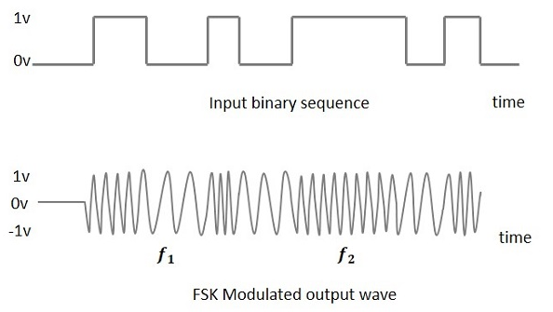
Frequency Shift Keying (FSK)
Frequency Shift Keying (FSK) is the digital modulation technique in which the frequency of the carrier signal varies according to the digital signal changes. FSK is a scheme of frequency modulation.
The output of a FSK modulated wave is high in frequency for a binary High input and is low in frequency for a binary Low input. The binary 1s and 0s are called Mark and Space frequencies. The following image is the diagrammatic representation of FSK modulated waveform along with its input

Slide 19
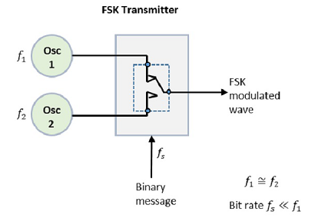
FSK Modulator
The FSK modulator block diagram comprises of two oscillators with a clock and the input binary sequence. The two oscillators, producing a higher and a lower frequency signals, are connected to a switch along with an internal clock. To avoid the abrupt phase discontinuities of the output waveform during the transmission of the message, a clock is applied to both the oscillators, internally. The binary input sequence is applied to the transmitter so as to choose the frequencies according to the binary input. Following is its block diagram.

Slide 20
FSK Demodulator
There are different methods for demodulating a FSK wave. The main methods of FSK detection are asynchronous detector and synchronous detector. The synchronous detector is a coherent one, while asynchronous detector is a non-coherent one.

Slide 21
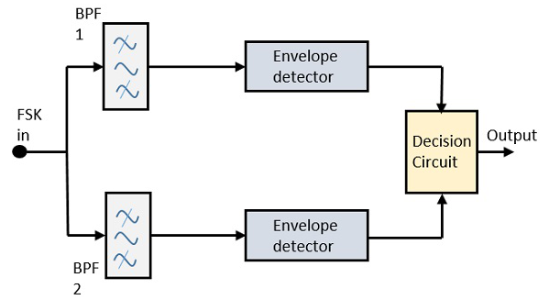
Asynchronous FSK Detector
The block diagram of Asynchronous FSK detector consists of two band pass filters, two envelope detectors, and a decision circuit. Following is the diagrammatic representation.

Slide 22
Asynchronous FSK Detector
The FSK signal is passed through the two Band Pass Filters (BPFs), tuned to Space and Mark frequencies. The output from these two BPFs look like ASK signal, which is given to the envelope detector. The signal in each envelope detector is modulated asynchronously.
The decision circuit chooses which output is more likely and selects it from any one of the envelope detectors. It also re-shapes the waveform to a rectangular one.

Slide 23
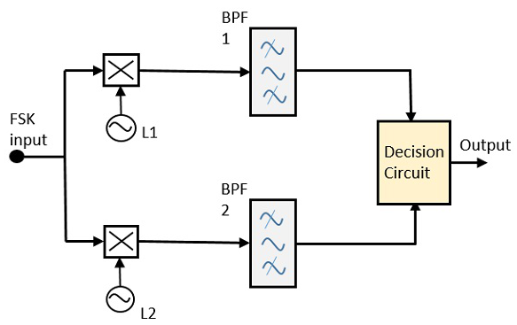
Synchronous FSK Detector
The block diagram of Synchronous FSK detector consists of two mixers with local oscillator circuits, two band pass filters and a decision circuit. Following is the diagrammatic representation.

Slide 24
Synchronous FSK Detector
The FSK signal input is given to the two mixers with local oscillator circuits. These two are connected to two band pass filters. These combinations act as demodulators and the decision circuit chooses which output is more likely and selects it from any one of the detectors. The two signals have a minimum frequency separation.
For both of the demodulators, the bandwidth of each of them depends on their bit rate. This synchronous demodulator is a bit complex than asynchronous type demodulators.

Slide 25
Phase Shift Keying (PSK)
Phase Shift Keying (PSK) is the digital modulation technique in which the phase of the carrier signal is changed by varying the sine and cosine inputs at a particular time. PSK technique is widely used for wireless LANs, bio-metric, contactless operations, along with RFID and Bluetooth communications.
PSK is of two types, depending upon the phases the signal gets shifted. They are −
Binary Phase Shift Keying (BPSK)
This is also called as 2-phase PSK or Phase Reversal Keying. In this technique, the sine wave carrier takes two phase reversals such as 0° and 180°.
BPSK is basically a Double Side Band Suppressed Carrier (DSBSC) modulation scheme, for message being the digital information.
Quadrature Phase Shift Keying (QPSK)
This is the phase shift keying technique, in which the sine wave carrier takes four phase reversals such as 0°, 90°, 180°, and 270°.
If this kind of techniques are further extended, PSK can be done by eight or sixteen values also, depending upon the requirement.

